Slide 1
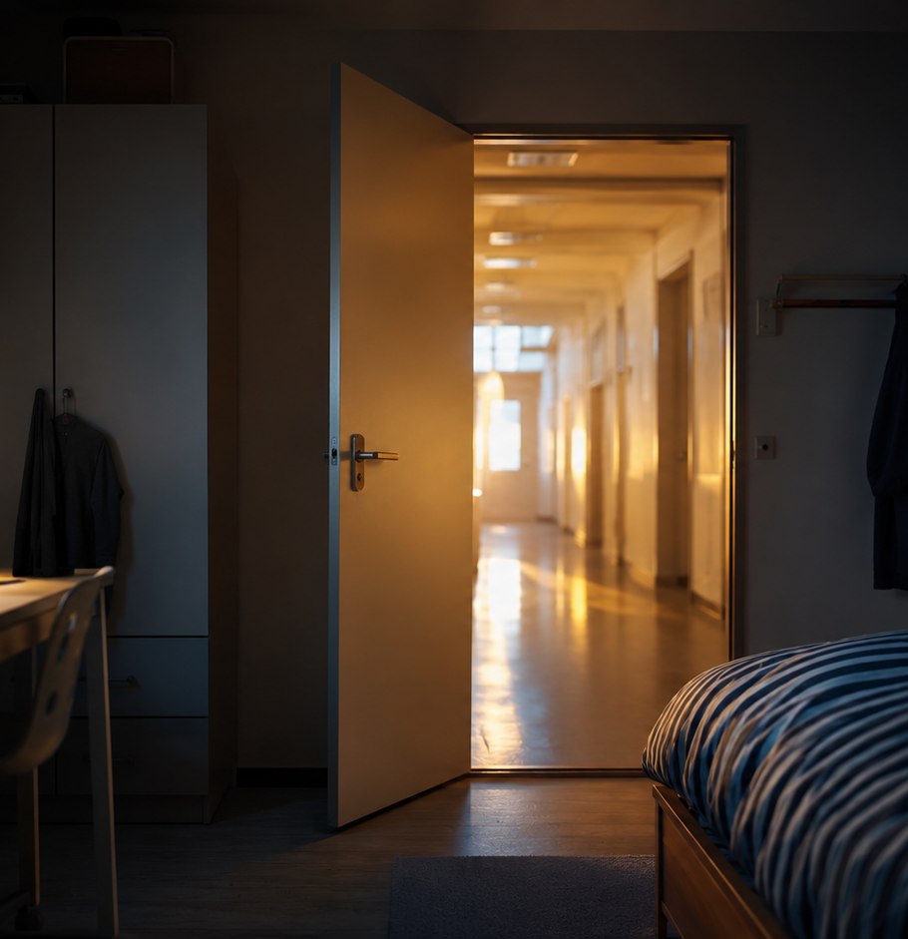
SEMH THINKING PAPER
Beyond
the Bedroom
A call to arms for the future of SEMH pupils
“Comfort must not quietly become confinement.”
A clear, compassionate challenge to schools, families, commissioners and specialist partners.

Slide 2
01 | THE HUMAN STARTING POINT
The bedroom can become a border.
refuge
Since Covid, disrupted attendance, reduced routines, increased anxiety and more time at home have changed the terrain for many pupils.
control centre
For some pupils with SEMH needs, autism, trauma or previous negative experiences of school, the room becomes refuge, control centre and hiding place.
hiding place
The risk is not the room itself. It is the gradual shrinkage of the world outside it.
The label matters less than what it describes: a child who has decided the world beyond the door is not safe to enter.

Slide 3
02 | COMPASSION AND HONESTY
Care cannot stop at comfort.
Families are often doing their best in emotionally exhausting circumstances. Blame closes doors.
But care also requires honesty.
relationships
routines
communication
resilience
independence
movement
reading
belonging
Lost learning hours are not neutral. They erode the building blocks of adulthood.

Slide 4
03 | THE ATTENDANCE PICTURE
The scale is national. The impact is personal.
Absence rates, year to date up to 1 May 2026
Special schools: 12.90% absence, compared with 5.11% primary and 8.18% secondary.
The figures describe special schools as a whole. When the lens narrows to SEMH, the challenge sharpens rather than softens.

Slide 5
04 | WHAT SUCCESS CAN LOOK LIKE
Movement is evidence.
For SEMH pupils, progress may begin before a worksheet is touched.
1. leaving the bedroom
2. entering the building
3. tolerating a trusted adult
4. ten minutes of learning
5. repairing a relationship
6. reading aloud again
7. a work related visit
8. believing school can be possible
These steps are not excuses. They are evidence of movement.

Slide 6
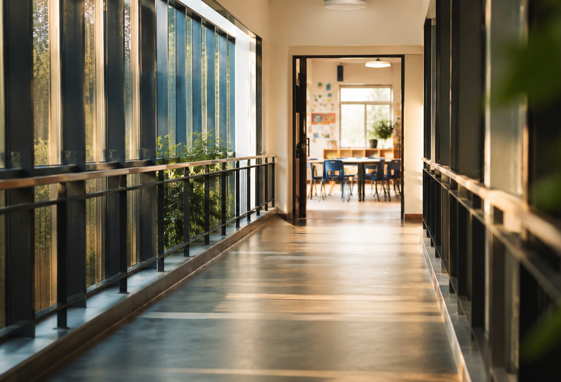
05 | WHAT PROVISION MUST DO
Build reasons to return.
Expectation matters, but it cannot stand alone.
Specialist schools must make learning more accessible, meaningful, creative and inviting.
That means emotionally safe classrooms, skilled adults, regulation, trauma-informed practice, literacy, life skills, therapeutic support, enrichment and practical pathways.
Learning should feel like a bridge.

Slide 7
06 | JUDGING AMBITION PROPERLY
Headline data cannot tell the full story.
starting points
Frameworks should examine attendance, outcomes and quality, while holding specialist context in view.
barriers addressed
use of resources
family engagement
progress over time
This does not mean lowering ambition. It means judging ambition properly.

Slide 8

07 | THE COLLECTIVE RESPONSE
Good practice should travel.
Attendance cannot be left to individual families, pupils or schools to solve alone.
Parents, schools, local authorities, commissioners, clinicians, therapists, social care partners and specialist providers need urgency and coherence.
Shared responsibility is the engine. Shared practice is the fuel.

Slide 9
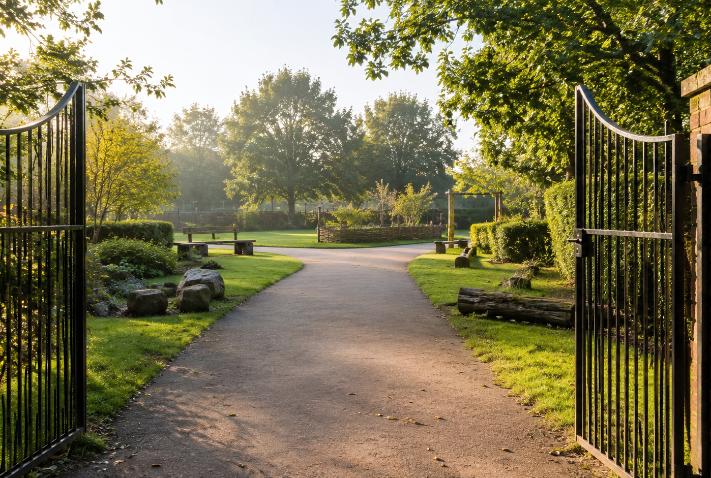
08 | THE AIM
Fuller, safer, more connected and more purposeful lives.
This is not about blaming families or excusing schools. It is about shared responsibility.
And that work belongs to all of us.
Comfort must not quietly become confinement. Lost learning must not become lost opportunity.

